Slide 1
The Onion vs Real News: Detecting Satire
Emiko Sano

Slide 2
What Is The Onion?
Satirical Media ‘News’
Print edition until 2013

Slide 3
The Questions
Can a model differentiate the text from The Onion and news subreddits?
Can the model predict the origin of the text with high accuracy?
What are the factors that contribute to the model?

Slide 4
Modeling Process
Obtaining Data
Requests using Pushshift Reddit API
150 x 100 requests for each subreddit
Cleaned Data
15000 from r/news
14978 from r/TheOnion
~ 31900 words total (mostly titles)
Model Data
Logistic Regression
Decision Tree
Random Forest
Naïve Bayes

Slide 5
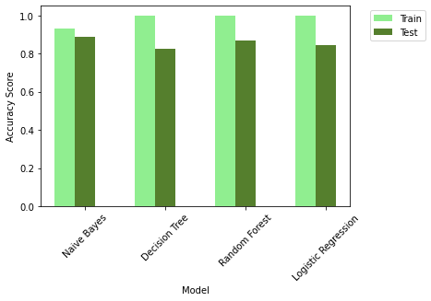
Accuracy Scores with Default Settings

Slide 6
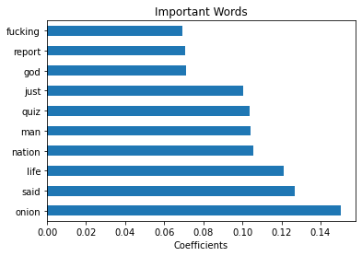
Logistic Regression Model: Words That Make a Difference to the Model
BEEP
Accuracy Scores
Train: 98.8 %
Test: 89.8 %

Slide 7
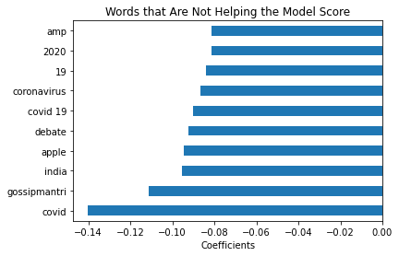
Logistic Regression Model Words That Don’t Make a Difference to the Model
Accuracy Scores
Train: 98.8 %
Test: 89.8 %

Slide 8
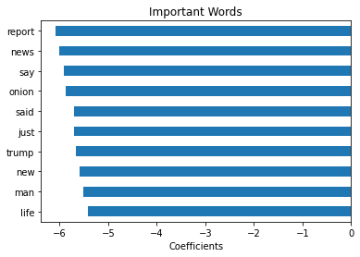
Naive Bayes Model: Words That Make a Difference to the Model
Accuracy Scores
Train: 93.1 %
Test: 88.7 %

Slide 9
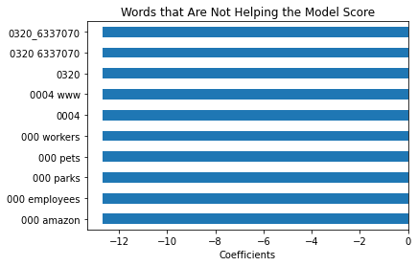
Naive Bayes Model Words That Don’t Make a Difference to the Model
Accuracy Scores
Train: 93.1 %
Test: 88.7 %

Slide 10
Summary and Conclusions
Can a model differentiate the text from The Onion and news subreddits?
Can the model predict the origin of the text with high accuracy?
– reached 89 % accuracy
There is room for improvement:
Clean data more
Using pre-trained word sets
Neural nets

Slide 11
Questions?

